Slide 1
Proteome-wide Screen for RNA-dependent Proteins
non-synchronized A549 cells
DataScience SS21 - Project 3 Group 4
Izar Schärf, Lukas link, Alexandra Kummer, Celina Schenkelberger

Slide 2
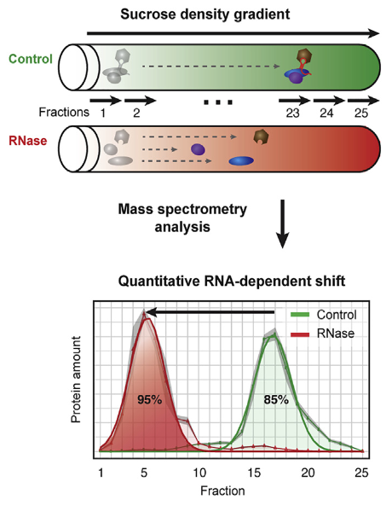
R-DeeP: Proteome-wide Screen for RNA-dependent Proteins
RNA-binding proteins (RBPs) play key regulatory roles in various central cellular processes: RNA biogenesis, regulation of gene expression, alternative splicing, …
malfunction of RBPs is origin of many diseases ranging from neurodegenerative disorders to cancer
R-DeeP : proteome-wide, unbiased, and enrichment-free screen, based on density gradient ultracentrifugation
defining a protein as RNA dependent when its interactome depends on RNA
RBPs are expected to migrate to different positions in a sucrose density gradient in the presence or absence of RNA
non-synchronized A549 cells: Human Caucasian lung carcinoma cells

Slide 3
Project goals
End goal is to perform analysis of the mass spectrometry data to automatically identify RNA-dependent proteins
Literature: Caudron-Herger et al., (2019), Molecular Cell 75, 184–199, 2019 Elsevier Inc.
Normalization and cleanup
Identification of maxima
Shift detection/clustering
Definition/Application of selection criteria
Further analysis and evaluation

Slide 4
Dataset
raw massspectrometry data from non-synchronized A549 cells
25 fractions
3 repetitions
3680 human proteins
Human protein | Fraction 1 Rep. 1 Ctlr | Fraction 1 Rep. 1 RNase | Fraction 1 Rep. 2 Ctlr | Fraction 1 Rep. 2 RNase | Fraction 1 Rep. 3 Ctlr | Fraction 1 Rep. 3 RNase | Fraction 2 Rep. 1 Ctlr | … Fraction 25
SPB6_HUMAN | 0.00 | 0.00 | 0.00 | 0.00 | 0.00 | 0.00 | 7370.80
CRYAB_HUMAN | 0.00 | 0.00 | 0.00 | 0.00 | 0.00 | 0.00 | 0.00
VIGLN_HUMAN | 0.00 | 0.00 | 0.00 | 0.00 | 0.00 | 0.00 | 0.00

Slide 5
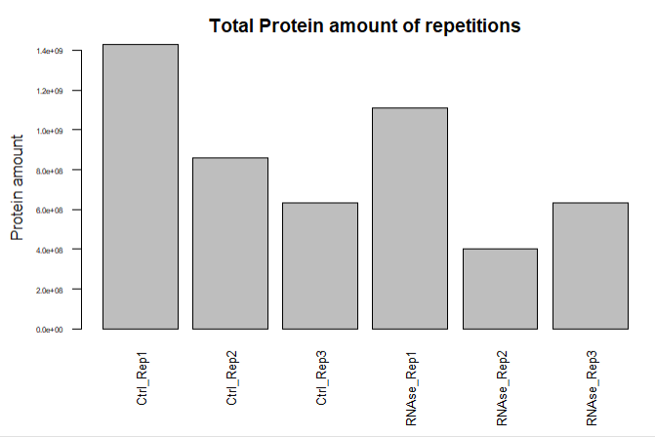
Dataset
Total protein amount of every repetition
Should be about equal for the three repetitions.
-> Normalization necessary

Slide 6
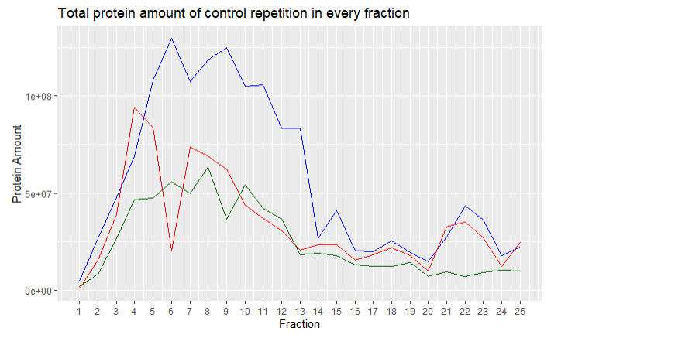
Dataset
Comparison of distribution of control replicates
-> course should be similar
Ctrl_Rep1
Ctrl_Rep2
Ctrl_Rep3

Slide 7
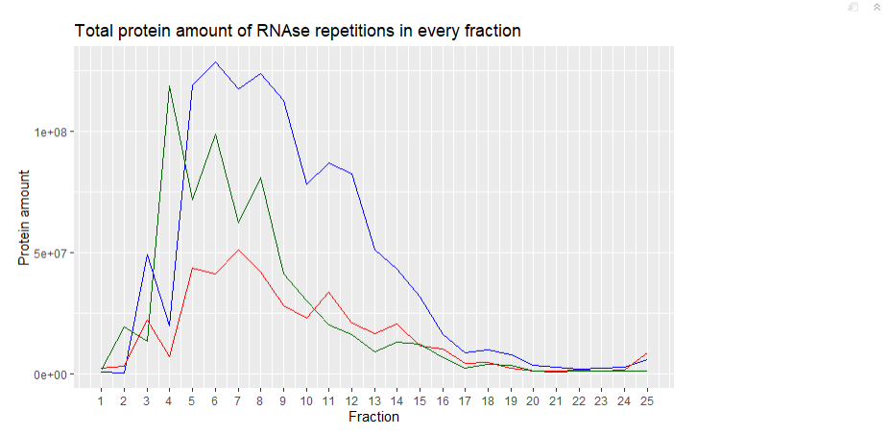
Dataset
Comparison of distribution of RNAse replicates
-> course should be similar
RNAse_Rep1
RNAse_Rep2
RNAse_Rep3

Slide 8
Normalization
2 new dataframes (df) (3*3680 x 25) one for the control group and one for the RNAse group
Human protein | Fraction 1 | Fraction 2 | Fraction 3 | Fraction 4 | Fraction 5 | Fraction 6 | Fraction 7 | … Fraction 25
SPB6_HUMAN Rep. 1 (Ctlr) | 0.00 | 7370.80 | 72064.00 | 111410.00 | 42962.00 | 2.9982e+04 | 10513.00
SPB6_HUMAN Rep. 2 (Ctlr) | 0.00 | 5419.70 | 63575.00 | 141020.00 | 38578.00 | 1.9908e+03 | 6228.00
SPB6_HUMAN Rep. 3 (Ctlr) | 0.00 | 3599.00 | 45914.00 | 80301.00 | 23125.00 | 1.4686e+04 | 5938.00

Slide 9
Milestone 1: Normalization
Planned analysis steps:
Calculate total protein sum for each repetition and divide the individual fractions for each protein by this sum.
Show graphics comparing the 3 repetitions to each other post normalization.
Delivers:
2 dataframes (df) (3*3680 x 25) one for the control group and one for the RNAse group, with normalized protein amounts.

Slide 10
Milestone 2: Cleanup
Planned analysis steps:
Perform the 3 cleanup methods(mean, median, mean with outlier exclusion) so all repetitions are integrated.
Show side by side comparision graphics of the cleanup methods for sample proteins.
Apply Wilcoxon test to identify proteins with no difference between control group and RNAse group.
Delivers:
6 df (3680x25) for 3 different cleanup methods. - > For each cleanup method one df for the control group and one df for the RNAse group without repetitions.
3 df (3680x1) containing the results of the Wilcoxon-test for each protein.

Slide 11
Milestone 3: Identification of maxima
Planned analysis steps:
Write a method that detects maxima.
Compare method results to graphics of sample proteins.
Adjust method parameters until maxima are accurately detected.
Delivers:
Function which detects maxima.
6 df (3680x?) containing the number and location of the maxima for each protein. - > For each of the three cleanup methods one df for the control group and one df for the RNAse group.

Slide 12
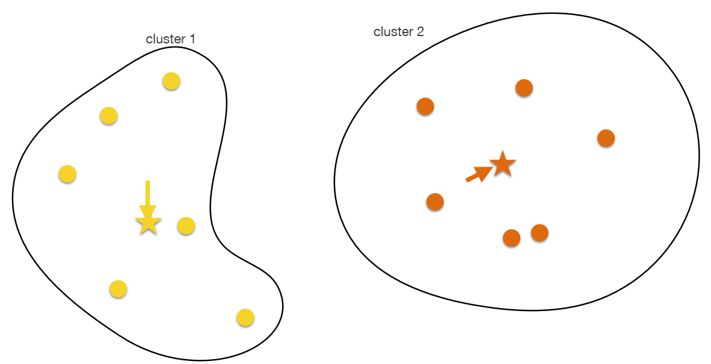
Milestone 4: Shift detection/clustering
Source: Lecture Computer Science Dr. Carl Hermann
Planned analysis steps:
Extract difference in maxima location between control group and RNAse group.
Figure out how to handle shifts for multiple maxima within the same protein.
Apply K-means clustering to separate proteins into groups based on their shift characteristics.
Delivers:
3 df (3680x?) containing the shift characteristics of the maxima for each protein.
3 df ( 3680x1) assigning each protein to a cluster.
Graphics showing the clustering of the different proteins.

Slide 13
Milestone 5: Definition/Application of selection criteria
Planned analysis steps:
Define which shift characteristics define a RNAse dependent Protein(RdP) (=selection criteria).
Apply selection criteria to the 3 df.
Analyze results by comparing the 3 cleanup methods to each other and to publication data.
Delivers:
3 logical df (3680x1) identifying each protein as RdP or not RdP.
3 df (4x1) containing the number of true/false positives and true/false negatives.

Slide 14
Milestone 6: Further analysis and evaluation
Planned analysis steps:
Log initial results.
Redo Milestones 1-5 with different parameters.
Identify which parameters are most important for accurate RdP identification. And which cleanup method is best suited.
Write project report + presentation
Delivers:
More df (3680x1) identifying each protein as RdP or not RdP.
More df (4x1) containing the number of true/false positives and true/false negatives.
Project report and presentation

Slide 15
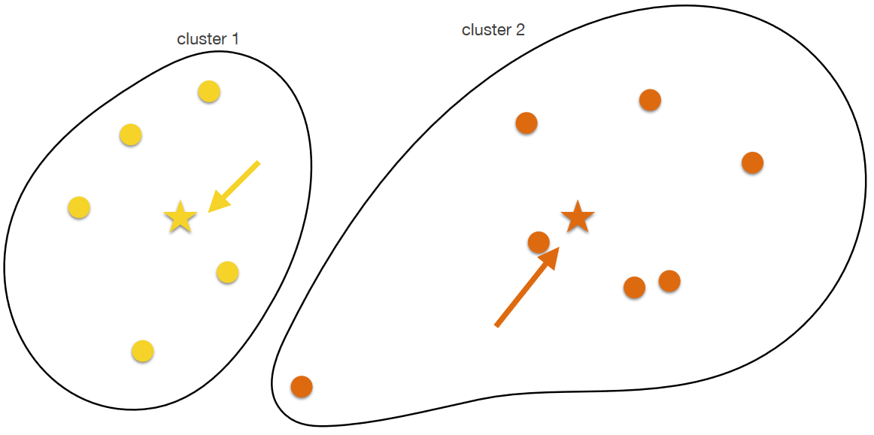
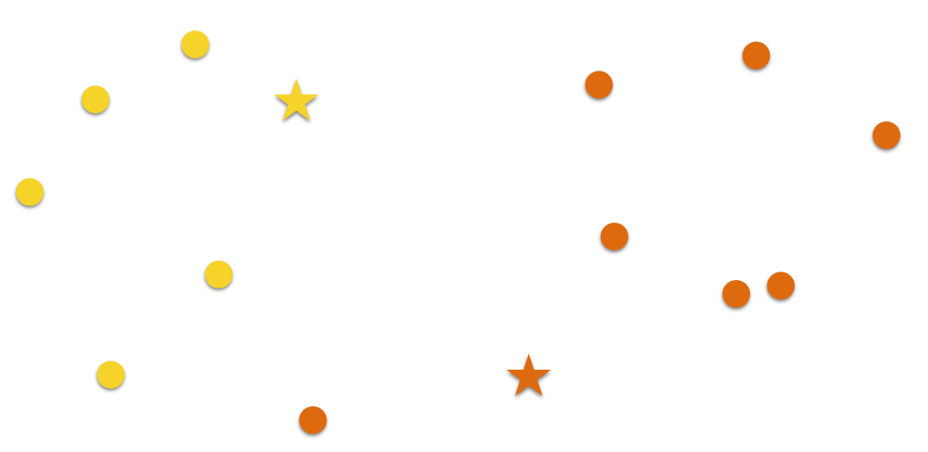
Milestone 4: K-means clustering
Choose k random points as centers
Assign each datapoint to the nearest center → cluster
determine center of gravity
Assign each datapoint to the nearest new center → new cluster
Repeat steps 3. & 4. until:
Predefined maximum number of iterations is reached
No datapoint changed its cluster
Source: Lecture Computer Science Dr. Carl Hermann

Slide 16
Milestone 4: K-means clustering
Choose k random points as centers
Assign each datapoint to the nearest center → cluster
determine center of gravity
Assign each datapoint to the nearest new center → new cluster
Repeat steps 3. & 4. until:
Predefined maximum number of iterations is reached
No datapoint changed its cluster
Source: Lecture Computer Science Dr. Carl Hermann

Slide 17
Timeline
Data cleanup
Maxima detection
Shift detection
Evaluation + Report
RdP identification
19.05 (1 week)
09.06 (3 weeks)
16.06 (1 week)
07.07 (2 weeks)
23.06 (1 week)
Since we do not know how much time we have exactly: If we need to be done by the start of July –1 week for Evaluation + Report If we have more time: +X weeks for maxima detection and shift detection.

